Slide 1

Importance of Algorithms
By: Esai Arias
CS 131: Discrete structures for computer science
Spring 2022

Slide 2
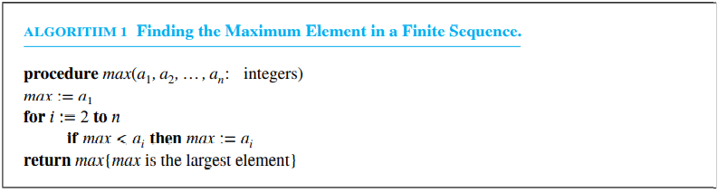
What is an algorithm ?
An algorithm is a finite sequence of precise instructions for performing a computation or for solving a problem.
With the growing interest in computing machines, the concept of an algorithm was given a more general meaning, to include all definite procedures for solving problems, not just the procedures for performing arithmetic.
Because of the different programming languages, pseudocode provides an intermediate step between an English language description of an algorithm and an implementation.

Slide 3
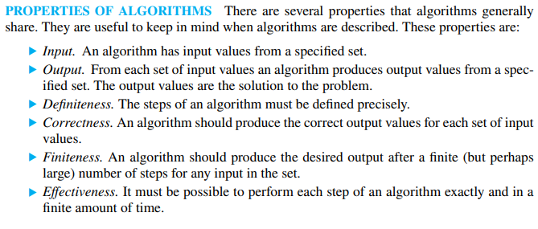

Properties of an algorithm

Slide 4
Types of algorithms
Searching algorithms
Linear search
Binary search
Sorting algorithms
Bubble sort
Insertion sort
String matching algorithms
Naïve string matcher
Greedy algorithms
Cashier’s algorithms
Arithmetic algorithms
The Euclidean algorithm (gcd)

Slide 5
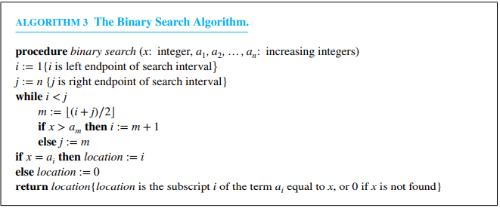
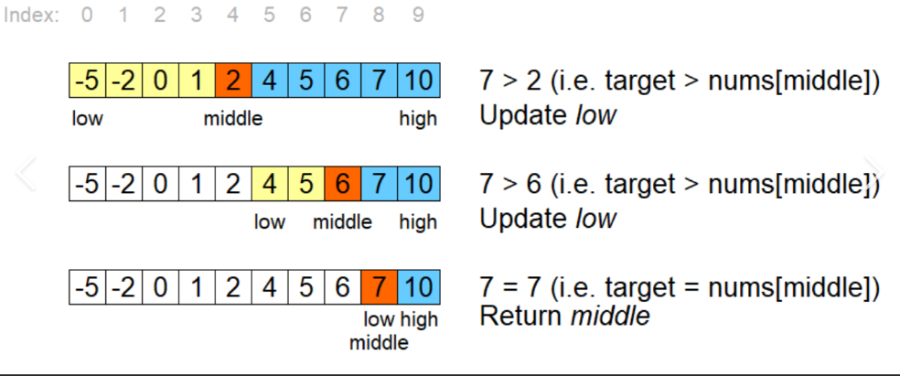
When to use algorithms
Searching Algorithms
Binary search – successively narrows down the part of the sequence being searched

Slide 6
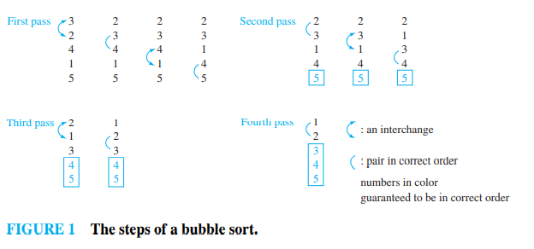
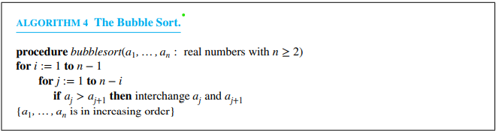
When to use algorithms
Sorting Algorithms
Bubble sort – is one of the simplest sorting algorithms, but not one of the most efficient. It puts a list into increasing order by successively comparing adjacent elements, interchanging them if they are in the wrong order.

Slide 7
Why are they important
Creating an efficient algorithm can save CPU power consumption.
Speed is everything and if algorithms can be made faster, programs can run faster
Considerations of the time and space complexity of an algorithm are essential when algorithms are implemented. It is important to know whether an algorithm will produce an answer in a microsecond, a minute, or a billion years.
As the age of information continues to grow, algorithms are an essential part of computer science because they are formulas that can solve any problem very quickly and efficiently.

Slide 8
